Slide 1
Memory Transmission in Small Groups and Large Networks
Chandhanu Mohan Kalamani – cm1573
Shashwenth Muralidharan – sm2785

Slide 2
About
How does the collaborative-memory paradigm help us understand the social influences on the transmission of learning and memory?
What are the practical constraints of past behavioral paradigms, and how does the agent-based modeling approach overcome them?
What insights can we gain from the agent model about the mechanisms behind counterintuitive phenomena such as collaborative inhibition and the results?

Slide 3
Simply Put
"Ever tried group studying?” FF15.. FF27 …
Too many cooks, spoil the broth.
How good is the food?
What’s the optimal level of chefs to make a delicious broth?
What type of phenomena occurs when chefs are added to the group size?
Let simulate this and study :p

Slide 4

Simply Put
"Ever tried group studying?” FF15.. FF27 …
Too many cooks, spoil the broth.
How good is the food?
What’s the optimal level of chefs to make a delicious broth?
What type of phenomena occurs when chefs are added to the group size?
Let simulate this and study :p

Slide 5
Introduction
Memory transmission in various group sizes: The study focuses on understanding how memory or information is transmitted or shared among different sizes of groups, from small teams to vast networks.
Experimental Limitations : Scalability to Large Networks.
Computational approach using agent-based models: Instead of traditional experimental methods, a computational model is used. This model simulates individuals as agents, allowing for a more scalable and flexible approach to studying memory transmission.
Goal to link behavior and information spread: The aim is to understand how individual behaviors relate to the broader spread of information within groups and networks.

Slide 6
Previous Studies and Limitations
They introduced collaborative-memory paradigm, providing valuable insights into the mechanisms of retrieval disruption and reexposure
Phenomena : collaborative inhibition and collective memory.
Limitations: However, the practical constraints of behavioral paradigms have limited past work to the study of small-scale social contexts, such as groups of two or three. The authors aim to overcome these limitations by taking an agent-based modeling approach, which allows for the investigation of the transmission of information within large groups.

Slide 7
Collaborative Memory
Cueing: One member's recall can serve as a cue for another member, triggering memories that might have remained inaccessible otherwise.
Pooling of Information: Different members might remember different parts of an event or information. When they come together, they can pool their memories, leading to a more comprehensive recall.
Error Correction: Group members can correct each other's mistakes, leading to a more accurate collective recall.

Slide 8
Collaborative inhibition
Retrieval Disruption: Group recall can disrupt individual retrieval strategies. For instance, if one person recalls events based on their emotional impact, it might disrupt another person who was recalling chronologically.
Social Dynamics: Dominant members might overshadow quieter ones, leading to reduced contributions from some group members.
Conformity Pressures: Individuals might suppress memories they believe diverge from the group's consensus.

Slide 9
Collaborative Memory in Small Groups
Paradigm measures info transmission: The collaborative memory paradigm is a method used to measure how information is shared within small groups.
Collaborative groups recall more but not to their full potential: When people work together to recall information, they remember more than they would individually. However, their combined recall is still less than the sum of what each person could recall separately.
Collaborative inhibition: the group's combined recall is less than its potential, attributed by the “Recall disruption”
Group size Vs Collaborative inhibition
Post-Collaboration Vs Collaborative Recall

Slide 10
1. Effect of Collaboration on Group Memory
Collaborative Recall vs. Individual Recall: Collaborative groups recall more than any single individual within the group. However, their combined recall is less than the potential recall if all individual recalls were simply added together.
Collaborative Inhibition: This is the observed phenomenon where the collaborative group's recall is less than its potential. The potential is measured by comparing the collaborative group's performance with a "nominal group". A nominal group is a hypothetical group where each member recalls individually, and their recalls are combined without any overlap.
Cause of Collaborative Inhibition: The primary reason for this inhibition is "retrieval disruption". This happens when one participant's recall process disrupts the recall process of another participant. For instance, if one person starts recalling events in a certain order, it might disrupt another person who was recalling based on a different strategy.

Slide 11
2. Group Size on Collaborative Inhibition
Increase in Collaborative Inhibition with Group Size: Research indicates that as the group size increases, collaborative inhibition also increases. For instance, groups of three or four members exhibit more collaborative inhibition than groups of two.
Retrieval Disruption and Group Size: The increase in collaborative inhibition with group size is attributed to the fact that retrieval disruption should logically increase with more members in the group.
Reexposure Mechanism: Despite the negative effects of collaboration, there are also positive mechanisms at play. One such mechanism is "reexposure", where collaboration exposes participants to items they might have forgotten. This can enhance post-collaboration recall.

Slide 12
3. Post-collaborative memory retrieval
Increased Memory Overlap: After collaborating, individuals show an increased overlap or similarity in the items they recall. This means that collaboration makes the memories of group members more alike.
Memory Transmission through Partners: Recent studies have shown that an individual's recall can be influenced by not just their immediate collaborative partners but also by the partners' previous collaborators. This means that memory can be transmitted indirectly through partners, even if two individuals never collaborated directly.
Computational Approach: The paper emphasizes the use of computational models to study memory transmission in larger social networks. This approach allows for the exploration of memory dynamics in large groups without the challenges of large-scale field studies.

Slide 13
Computational Model: Agent based Modeling
Agents as simplified individuals: In the computational model, individuals are represented as agents. These agents have specific rules and behaviors that mimic human memory processes.
Transition from small groups to large networks: The model allows for studying memory transmission in settings ranging from small groups to vast networks.
Insights beyond experimental methods: Using this computational approach provides insights that would be challenging to obtain using traditional experimental methods due to scalability and flexibility.

Slide 14
Agent based Modeling…
Memory models and behaviors of agents: Each agent in the model has a memory structure that can store items and has behaviors like encoding (storing) and retrieving (recalling) information. Simulating human-like memory processes in a controlled environment.
Encoding and retrieval processes: Agents can take in new information and store it (encode) and can also recall or bring up stored information (retrieve).
Activation modifications: The likelihood of an agent recalling a piece of information can change based on various factors, like recent recall or exposure to that information.

Slide 15
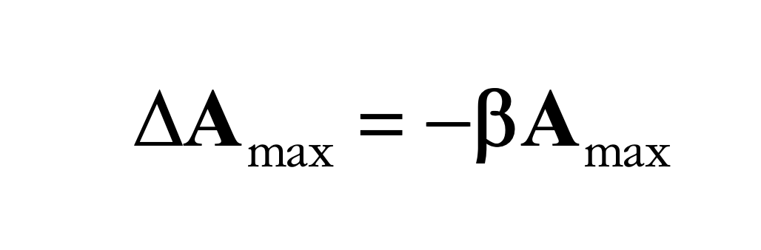
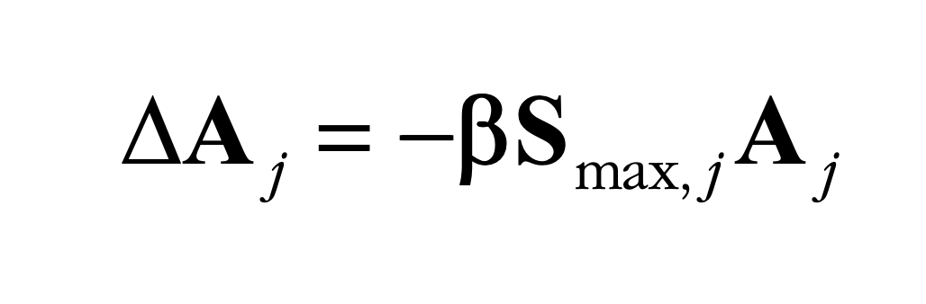
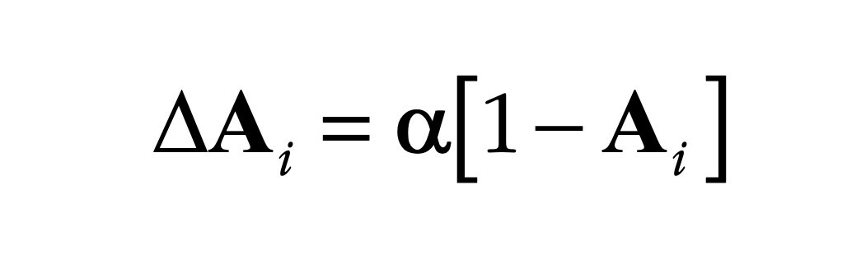
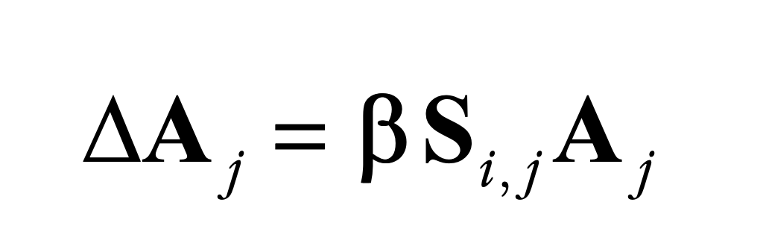
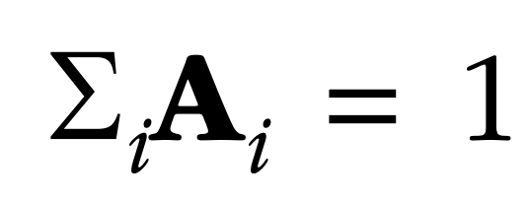
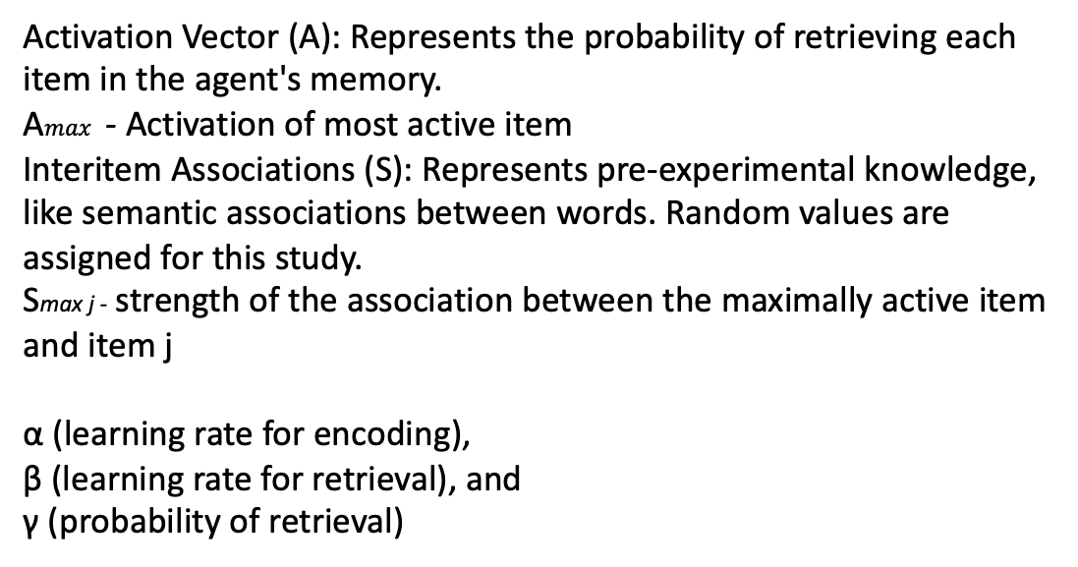
Agent based Modeling…
Activation Vector (A): Represents the probability of retrieving each item in the agent's memory.
A$max⁡$ - Activation of most active item
Interitem Associations (S): Represents pre-experimental knowledge, like semantic associations between words. Random values are assigned for this study.
Smax j - strength of the association between the maximally active item and item j α (learning rate for encoding),
β (learning rate for retrieval), and
γ (probability of retrieval)

Slide 16
This equation reduces the activation of the most active item in the agent's memory.
When a new item is to be encoded and it's not the most active item, the activation of the most active item is reduced using this formula.
By reducing the activation of the most active item, it ensures that no single item dominates the agent's memory, allowing for a more balanced recall.
This formula ensures that the agent's memory remains dynamic and adaptable, preventing over-reliance on a single dominant memory item.
Notes:
Formula: ∆A max = −β Amax (1)
Components:
∆A max: This represents the change in activation of the most active item in the agent's memory.
β: This is the learning rate for retrieval. It's a constant that determines the rate at which the activation of the most active item is reduced.
Amax: This represents the current activation level of the most active item.
Role:
The formula's primary role is to reduce the activation of the most active item in the agent's memory when a new item is to be encoded and it's not the most active item.
Implementation:
When the agent encounters a new item to be encoded, and this item isn't the most active one in its memory, the activation of the most active item is reduced using this formula. This reduction is proportional to its current activation level and is scaled by the learning rate β.
Influence on Results:
By reducing the activation of the most active item, the formula ensures that no single memory item dominates the agent's recall process. This allows for a more balanced recall and prevents over-reliance on a single dominant memory item.
Meaning:
In cognitive terms, this formula captures the idea that when we learn or focus on new information, the prominence or "activation" of previously dominant information can decrease. It ensures that the agent's memory remains dynamic and adaptable, allowing for the integration of new information without being overshadowed by previously dominant memories.
In essence, this formula is a mechanism to ensure that the agent's memory remains flexible and can adapt to new information, reflecting a key aspect of how human memory operates.

Slide 17
This equation modifies the activations of semantic associates of the maximally active item.
After reducing the activation of the most active item (using Equation 1), the activations of its semantic associates are modified using this formula.
By modifying the activations of related items, it ensures that items semantically related to a dominant memory item are also considered during recall.
This captures the interconnectedness of memories, reflecting how recalling one item can trigger related memories.
Notes:
Role:
This equation modifies the activations of semantic associates of the successfully retrieved item. In simpler terms, when an item is recalled, this formula determines how the recall of that item influences the activation levels of items that are semantically related to it.
Implementation:
After an agent successfully retrieves an item, the activations of its semantic associates (related items) are adjusted using this formula. The adjustment is based on the strength of the association between the retrieved item and its associates, as well as the current activation level of the associates.
Influence on Results:
By adjusting the activations of related items based on a successful retrieval, this formula ensures that items related to a recently recalled item also get a boost in activation. This can lead to a chain reaction where recalling one item can make it easier to recall related items in subsequent retrieval attempts.
Meaning:
This formula captures a fundamental aspect of human memory: the interconnectedness of memories. In human cognition, when we remember something, it often triggers related memories. For instance, recalling a beach vacation might make it easier to remember the name of the beach town, the seafood restaurant you visited, or the song that was playing on the radio. This formula models that phenomenon, reflecting how memories are not isolated but are interconnected in a web of semantic relationships.
In essence, this formula ensures that the agent's memory model behaves in a way that mirrors the associative nature of human memory, where recalling one piece of information can influence the recall of related information.

Slide 18
This equation modifies the activation of item i based on its association with item j and the current activation of item j.
When item j is retrieved or activated, the activation of item i is adjusted based on their association strength and the learning rate.
By adjusting the activation of related items based on their association strength, it ensures that items related to a recently recalled item also get adjusted in their activation, making them more or less likely to be recalled next.
Notes:
Formula: ∆Ai = βS i , j A j
Components:
∆Ai: Change in activation of item i.
β: Learning rate for retrieval.
Si,j: Strength of the association between items i and j.
Aj: Activation of an associate of item j.
Role: This equation calculates the change in activation for item i based on its association with another item j and the current activation of item j.
Implementation: When an agent retrieves an item (item j), the activations of its semantic associates (like item i) are modified using this formula. The stronger the association between the two items, and the higher the activation of item j, the greater the change in activation for item i.
Influence on Results: This formula ensures that when an item is retrieved or activated, other items that are semantically related or associated with it also get their activations adjusted. This can lead to a chain reaction where recalling one memory can influence the recall of several related memories.
Meaning: In human memory, when we think of one thing, it often reminds us of something related. This formula captures that phenomenon in the agent's memory model. It reflects the interconnectedness of memories and how the activation or recall of one memory can influence the activations of related memories.
In essence, this formula is a representation of how memories are interconnected and influence each other within the agent's memory model. When one memory item is activated, it can boost or modify the activations of other related memory items, simulating the associative nature of human memory.

Slide 19
This equation increases the activation of the item that is being encoded.
When an agent encodes a new item, its activation is increased using this formula.
By increasing the activation of newly encoded items, it ensures that recent memories are more readily accessible for recall.
This formula reflects the phenomenon where recent memories are often more vivid and easier to recall.
Notes:
Formula: ∆Ai = α[ 1 - Ai]
Components:
∆Ai: Represents the change in activation of the item "i".
α: Learning rate for encoding. It determines the rate or speed at which the agent's memory adapts to new information.
Ai: Current activation of the item "i" in the agent's memory.
Role:
This equation determines how much the activation of a particular item "i" should be increased when it is being encoded or remembered.
Implementation:
When an agent encounters a new item or is trying to encode an item, the activation of that item in the agent's memory is increased using this formula. The formula calculates the change in activation based on the current activation and the learning rate.
Influence on Results:
The formula ensures that items with lower initial activation (less remembered or less familiar items) get a larger increase in activation compared to items that are already highly activated (well-remembered or familiar items).
It ensures that the activation of an item doesn't exceed a certain limit. As Ai approaches 1, the change in activation ∆Ai approaches 0.
Meaning:
This formula captures a fundamental aspect of memory encoding:
Adaptability: The agent's memory is dynamic and can adapt to new information, with the rate of adaptation determined by α.
Diminishing Returns: As an item becomes more and more activated (or remembered), the benefits of additional encoding decrease. In other words, if you already know something very well, going over it again doesn't help as much as if you were less familiar with it.
In essence, the formula ∆Ai = α[ 1 - Ai] ensures that the agent's memory remains balanced and adaptive, reflecting the way humans tend to remember or encode information. It ensures that new or less familiar information gets prioritized in memory encoding, while already well-known information gets lesser emphasis.

Slide 20
After all encoding and retrieval operations, the activations are normalized using this formula.
By normalizing activations, it ensures that each entry in the activation vector can be interpreted as a proper probability, maintaining the balance and proportionality of memories.
This the consistency and integrity of the agent's memory model, making sure that the total activation remains constant.

Slide 21
Example
Step 1: Initialization:
Each agent starts with an activation vector `A` and an association matrix `S`. For simplicity, we'll consider the activation vector for Alice:
Activation Vector `A` (represents the probability of retrieving each word):
Cat: 0.34
Dog: 0.33
Bird: 0.33
# of items = 3

Slide 22
Example
Step 2: Encoding:
Alice is presented with the word "Dog" to encode.
Using Equation 1, the activation of the most active item is reduced. Since all items are equally active initially, we'll consider "Cat" as the most active item for this example:
∆Amax = −β * Amax
Given β = 0.05, and Amax (Cat) = 0.34,
∆Amax = -0.05 * 0.34 = -0.0165
The new activation for "Cat" becomes:
0.34 - 0.0165 = 0.3235

Slide 23
Example
Step 3: Adjust Semantic Associations: Using Equation 2, semantic associates of "Cat" have their activations modified. Since "Dog" is a positive associate of "Cat" with a strength of 0.1, its activation increases:
Increasing Activation for "Dog" (Using Equation 3):
∆A_i = α[1 - A_i]
Given α = 0.05 (as an example) and A_i (Dog) = 0.33:
∆A_i = 0.05[1 - 0.33] = 0.05 * 0.67 = 0.0335
New Activation for "Dog" = 0.33 + 0.0335 = 0.3635

Slide 24
Example
Adjusting values of Bird, to normalize the sum of probabilities to 1
Value adjusted for A(Dog) = 0.0335 Value adjusted for A(Cat) = 0.0165 Sum of differences = 0.017
New Activation for Bird = A(Bird) = 0.33-0.017 = 0.313

Slide 25
Example
Item | Activation probablities
Cat | 0.3235
Dog | 0.3635
Bird | 0.313

Slide 26
Study 1: Validating the Agent Model
Task design and agent interactions: The study designed tasks that closely mimic real-world memory tasks. Agents interacted in these tasks, simulating real-world group interactions.
Collaborative inhibition observed: The study found that agents, when working together, exhibited collaborative inhibition, just like humans do.
Impact of precollaboration similarity on recall: The more similar agents were in their memory structures before collaborating, the less effective their combined recall was.
Notes:
Study 1: Validating the Agent Model
Task Design:
The study was designed to mirror the standard laboratory paradigm of collaborative memory as closely as possible.
Each agent was first allowed to encode a study list of 40 items, presented in a random order.
Groups of three agents then interacted in a structured manner over 20 rounds. In each round, each agent had an opportunity to retrieve an item. The order of retrieval was randomized in each round.
If an agent successfully retrieved an item, it was encoded by the other two agents. If an agent tried to retrieve an already retrieved item, the retrieval failed, and the next agent got a chance.
Variables Initialized:
Study List: A list of 40 items for encoding.
Rounds: 20 rounds of interaction.
Agent Memory: Each agent had an activation vector representing the memory of items.
Environment:
The environment was a simulated setting that allowed agents to interact in a structured manner, mimicking both laboratory settings and real-world environments.
Number of Agents:
Agents were grouped into triads (groups of three).
The study created pairs of groups, resulting in 1,000 collaborative groups and 1,000 nominal groups, making a total of 6,000 agents.
Comparisons:
The performance of collaborating agents was compared to the performance of individual agents (nominal groups).
In nominal groups, agents studied and recalled in isolation. The nonredundant output of this nominal group was taken as the expected output of individual agents, against which the collaborative group performance was compared.
Performance:
The simulated agents exhibited collaborative inhibition, a phenomenon where collaborative groups recall more than an individual but not to their full potential.
Collaborative groups retrieved significantly fewer items than their counterparts in nominal groups.
The study found that the greater the similarity between agents before collaborating, the lower the recall performance of the nominal groups.
Size:
The study used a large sample size, simulating 1,000 separate pairs of groups (1,000 collaborative groups and 1,000 nominal groups). This large sample size provided greater statistical power than typical behavioral studies.

Slide 27
Results
Collaborative recall among agents leads to a phenomenon called collaborative inhibition, where group recall is less than individual recall.
The more similar agents are before collaboration, the fewer unique items they recall, leading to reduced group performance.
Collaboration tends to make agents' memories more similar, which can be both beneficial (for memory convergence) and detrimental (for diverse recall).
Notes:
Comparisons & Performance:
The study compared the performance of collaborating agents (those that worked together) with the performance of individual agents (those that worked in isolation).
The non-redundant output of individual agents was termed as the "nominal group" and was used as a benchmark to compare against the collaborative group's performance.
Pattern Observed by Simulated Agents:
The simulated agents exhibited a pattern known as "collaborative inhibition". This means that while collaborative groups recalled more items than individual agents, they did not recall as many as the combined potential of the individual agents. In other words, three agents working together did not recall as much as three agents working separately and then combining their results.
Diversity:
Before collaboration, each agent had a unique pattern of activation over the set of items, leading to a diverse set of memories. This diversity should, in theory, allow for a richer recall when agents collaborate. However, during collaboration, agents' memories became more similar, leading to a reduction in this diversity.

Slide 28
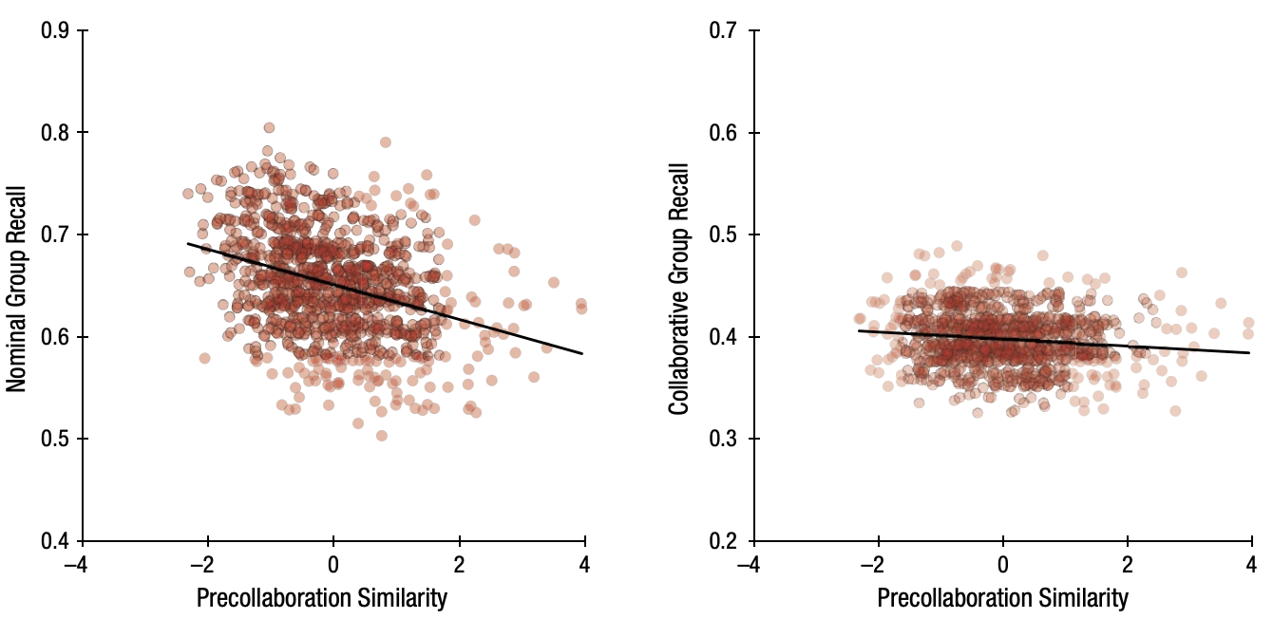
Results
Notes:
Collaborative Inhibition:
Collaborative groups retrieved significantly fewer items than their counterparts in nominal groups. This phenomenon, where the combined recall of a collaborative group is less than the sum of individual recalls, is termed "collaborative inhibition."
Impact of Precollaboration Similarity:
The study introduced a metric called "precollaboration similarity," which measures how similar the agents' memories were before they started collaborating.
For nominal groups, there was a negative relationship between precollaboration similarity and recall performance. In other words, the more similar the agents were before collaboration, the lower the recall performance of the nominal groups.
For collaborative groups, the relationship between precollaboration similarity and recall performance was weaker. This suggests that collaboration affects the dynamics of recall, potentially due to the convergence of memories during collaboration.
Memory Convergence:
Collaborative recall led to a convergence in memory among group members. After collaboration, group members' memories became more similar than before. This convergence is believed to be a significant factor behind the collaborative groups' lower recall performance.
Visualization Insights:
The results were visualized using two plots, one for nominal groups and one for collaborative groups. These plots showed the relationship between precollaboration similarity and recall performance.
It's important to note that the two plots did not use a common y-axis, which means the scales might differ, and direct comparisons should be made with caution.
Data points were jittered vertically in the plots to improve clarity and comprehension.
Conclusion:
The results of Study 1 validate the agent-based model by demonstrating collaborative inhibition, a well-documented phenomenon in human memory research. The findings also highlight the importance of precollaboration similarity in influencing recall performance, especially in the context of collaborative recall. The visualizations provide a clear representation of these relationships, emphasizing the distinct dynamics between nominal and collaborative groups.

Slide 29
Study -2: Group Size
Aim: How collaborative inhibition is affected by the Group Size
Prior Studies says “YES”.
But were they concrete evidence?? The author feels not!
Why? The earlier studies had no more than 4 participants.
So, it makes it difficult to compare with a larger set of groups.

Slide 30
Current Approach
Same agent model used in study 1
The collaborative group size varied from 2-128 agents.
The entire list of 40 items were presented to the agents.
All the agents in the group were then allowed to interact
1000 simulations were performed on each group size.

Slide 31
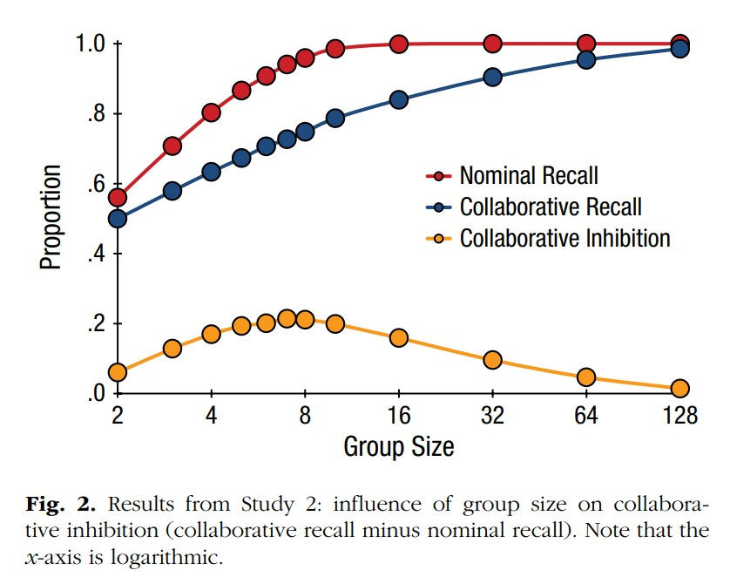
Result

Slide 32
Result
1. Collaborative Inhibition Observed Across All Group Sizes:
For all group sizes, collaborative inhibition was observed, meaning groups consistently recalled fewer items than individual agents.

Slide 33
Result
2. Group Size Relationship with Collaborative Inhibition:
For smaller group sizes, from 2 to 7 agents, the extent of collaborative inhibition increased with group size. This means that as these groups got larger, their relative inefficiency compared to individual agents also increased.
Both collaborative groups (those working together) and nominal groups (individual agents) performed better as their size increased from 2 to 7. However, the gains in performance were more significant for nominal groups compared to collaborative ones.

Slide 34
Result
2. Group Size Relationship with Collaborative Inhibition:
Beyond a group size of 7, the extent of collaborative inhibition started to decrease. This means that as groups grew even larger, they started becoming relatively more efficient compared to their smaller counterparts, though still less efficient than individual agents.
The reduction in collaborative inhibition for larger groups (beyond 7 members) can be attributed to the nominal groups reaching a performance ceiling earlier than collaborative groups. Essentially, individual agents had maximized their potential recall, while larger groups still had room for improvement.

Slide 35
Interpretation:
The relationship between group size and collaborative inhibition seemed to be influenced by two factors:
Facilitative Effects of Collaboration: As groups got bigger, the chances of the group recalling a specific item increased. This is because having more members increases the likelihood that at least one member remembers a given item.
Detrimental Effects of Retrieval Disruption: Larger groups also meant more chances of members disrupting each other's recall processes.

Slide 36
Study-3: Transmission of Memory in Social Networks
Objective:
The main aim of Study 3 is to understand how memory gets transmitted through large, intricate social networks, something that is hard to achieve with traditional behavioral studies.

Slide 37
Agent-based Model & Its Benefits:
Agent-based Model & Its Benefits:
The researchers used an agent-based model to simulate how memories are transmitted. This model is beneficial for:
1. Studying complex social structures.
2. Investigating the convergence of memories among agents and the effect of hyperdyadic spread. This spread refers to the similarity in memories between two individuals who haven’t directly communicated but have a common friend or connection.

Slide 38
Three Types of Social Networks Used:
1. Small-world Network: Created using an algorithm by Watts & Strogatz (1998), this network mirrors real social networks, where most nodes aren't directly connected, but the distance between any two nodes is relatively short (hence, the six-degrees-of-separation phenomenon). The researchers created a network with 100 nodes where each node (or agent) was connected to 4 other agents on average.

Slide 39
Three Types of Social Networks Used:
2. Karate Club Network: This network is based on real-life data, showing friendships between members of a karate club at a U.S. university. It consists of 34 individuals with 78 connections among them.

Slide 40
Three Types of Social Networks Used:
3. Authorship Network: Another real-life network, this one represents coauthorship relationships among scientists studying networks. It includes 376 nodes with 914 connections.

Slide 41
Simulation Process:
Each agent was exposed to a list of 40 items.
The simulation spanned 800 time steps. In each step, every agent interacted with one of its neighbors, recalling an item, similar to the interactions in Studies 1 and 2. However, unlike previous studies, each agent only interacted with one other agent, not with the entire network. This mimics real-world interactions (like two scientists sharing information).
The researchers were particularly interested in the diffusion of memory across these networks. To measure this, they calculated the similarity of memories based on the agents’ proximity in the network, which is gauged by the minimum number of connections (hops) required to link two agents.
1,000 simulations were conducted for each of the three networks.

Slide 42
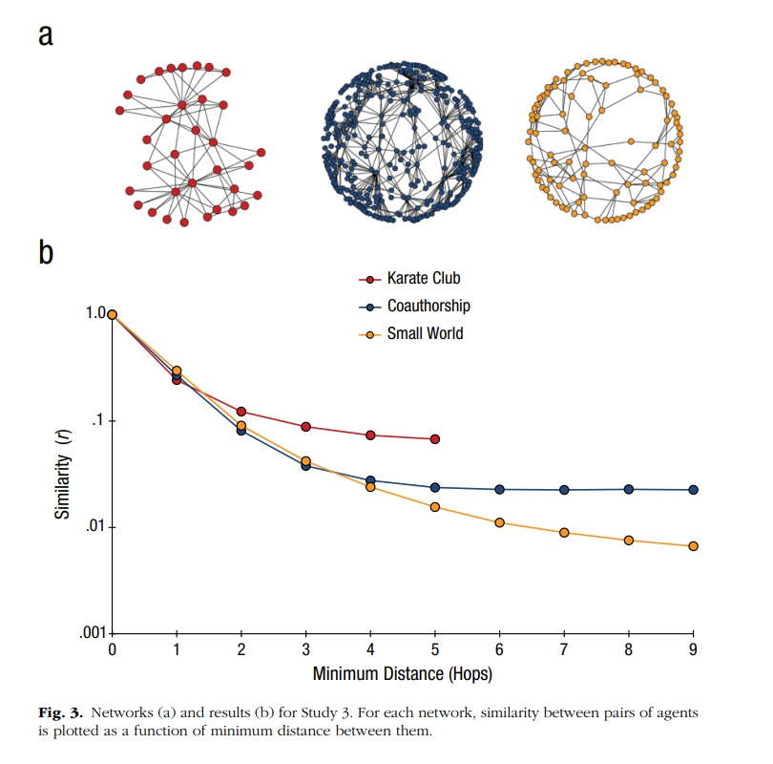
Result

Slide 43
Results
Directly Connected Agents (1 Hop Apart): As expected, agents directly connected in the network had more similar memory representations, primarily because they interacted directly.
Agents 2 Hops Apart: Interestingly, agents two hops apart (not directly connected but having a mutual connection) also had somewhat similar memory representations. The shared mutual connection likely acted as a medium, transferring memory from one agent to the other.

Slide 44
Results
Decreasing Similarity with Distance: As the distance between agents in terms of hops increased, the similarity in their memories decreased. For instance, agents three hops apart were less similar than those two hops apart. This trend continued until agents were either seven hops (in the authorship network) or six hops (in the small-world network) apart. Beyond this distance, there wasn’t any significant difference in memory similarity regardless of the actual distance between agents

Slide 45
Inference
The study concludes that memory transmission in social networks isn't just a result of direct interactions. It is influenced by the structure of the network and indirect interactions through common connections. This pattern of memory spread resembles how behaviors, trends, or information spread through social networks in what is termed as "contagion." Such patterns in memory spread underscore the importance of understanding the structure and dynamics of social networks when considering the transmission of memories or information in society.

Slide 46
General Discussion
How do the findings from Luhmann and Rajaram's model reshape our strategies for managing information in large online social networks? What implications could these have in efforts to combat misinformation on digital platforms?"

Slide 47
General Discussion
How do the findings from Luhmann and Rajaram's model reshape our strategies for managing information in large online social networks? What implications could these have in efforts to combat misinformation on digital platforms?”

Slide 48
General Discussion
Discussion Question: Can we repeat this experiment with LLM agents conversing in interactive dialogue and see if the results are similar, instead of building a computational module for memory?
Notes:
Recreating the results of a paper by using LLM (language models like ChatGPT) in interactive dialogues would be an innovative approach. However, there are some considerations to keep in mind:
Nature of Agents: The original study seems to be grounded in human memory and recall, especially in collaborative settings. LLMs do not possess human-like memory or the ability to forget; they retrieve information based on patterns in the data they were trained on. Therefore, they don't "remember" in the traditional sense.
Collaborative Inhibition: One of the phenomena discussed is the collaborative-inhibition effect, where collaborative groups may underperform compared to individual recall. This is a distinctly human phenomenon arising from factors like retrieval disruption in group settings. LLMs don't have such inhibitions, so replicating this exact effect might not be feasible.

Slide 49
General Discussion
Discussion Question: How might external influences, such as media or influential figures, interact with the dynamics of memory transmission in large-scale networks as suggested by the model?"
Notes:
Amplification of Certain Memories: Media outlets and influential figures have the power to emphasize specific events, facts, or narratives, making them more salient in the collective memory. This amplification can increase the probability that these memories are transmitted across the network.
Introduction of Biases: Media and influential figures can introduce biases—either unintentionally due to the nature of storytelling and simplification, or intentionally for various reasons. These biases can shape the way memories are recalled, discussed, and transmitted, potentially skewing the collective understanding of events.

Slide 50
General Discussion
Discussion Question: how can the agent based methods of this research be used to study “social media bubbles”, and can the results of this research be used by social media platforms, and those who use them, to help combat the spread of misinformation and the effects of these “social media bubbles”?
Notes:
Modeling Echo Chambers:
Agents can be programmed to simulate social media users with varying beliefs and tendencies to engage with like-minded individuals. Over time, these agents can form clusters or bubbles that represent echo chambers, where similar beliefs are amplified and dissenting views are minimized.
Understanding Information Spread:
By studying how agents share, accept, or reject information based on their programming (e.g., susceptibility to confirmation bias), researchers can get insights into how misinformation or biased views spread within these bubbles.

